Slide 1
Inheritance Concept
class Rectangle{
private:
int numVertices;
float *xCoord, *yCoord;
public:
void set(float *x, float *y, int nV);
float area();
};
Polygon
Rectangle
Triangle
class Polygon{
private:
int numVertices;
float *xCoord, *yCoord;
public:
void set(float *x, float *y, int nV);
};
class Triangle{
private:
int numVertices;
float *xCoord, *yCoord;
public:
void set(float *x, float *y, int nV);
float area();
};

Slide 2
Inheritance Concept
class Polygon{
protected:
int numVertices;
float *xCoord, float *yCoord;
public:
void set(float *x, float *y, int nV);
};
Polygon
Rectangle
Triangle
class Rectangle{
protected:
int numVertices;
float *xCoord, float *yCoord;
public:
void set(float *x, float *y, int nV);
float area();
};
class Rectangle : public Polygon{
public:
float area();
};

Slide 3
Inheritance Concept
class Polygon{
protected:
int numVertices;
float *xCoord, float *yCoord;
public:
void set(float *x, float *y, int nV);
};
Polygon
Rectangle
Triangle
class Triangle{
protected:
int numVertices;
float *xCoord, float *yCoord;
public:
void set(float *x, float *y, int nV);
float area();
};
class Triangle : public Polygon{
public:
float area();
};

Slide 4
Inheritance Concept
class Point{
protected:
int x, y;
public:
void set (int a, int b);
};
Point
x
y
Circle
3D-Point
x
y
r
x
y
z
class Circle : public Point{
private:
double r;
};
class 3D-Point: public Point{
private:
int z;
};

Slide 5
Inheritance Concept
Augmenting the original class
Specializing the original class
Polygon
Point
Rectangle
Triangle
Circle
3D-Point
ComplexNumber
real
imag
RealNumber
ImaginaryNumber
imag
real

Slide 6
Why Inheritance ?
  Inheritance is a mechanism for
    building class types from existing class types
    defining new class types to be a
      specialization
      augmentation
    of existing types

Slide 7
Define a Class Hierarchy
Syntax:
class DerivedClassName : access-level BaseClassName
where
  access-level specifies the type of derivation
    private by default, or
    public
Any class can serve as a base class
  Thus a derived class can also be a base class

Slide 8
Class Derivation
Point
class Point{
protected:
int x, y;
public:
void set (int a, int b);
};
3D-Point
Sphere
class 3D-Point : public Point{
private:
double z;
… …
};
class Sphere : public 3D-Point{
private:
double r;
… …
};
Point is the base class of 3D-Point, while 3D-Point is the base class of Sphere

Slide 9
What to inherit?
In principle, every member of a base class is inherited by a derived class
  just with different access permission

Slide 10
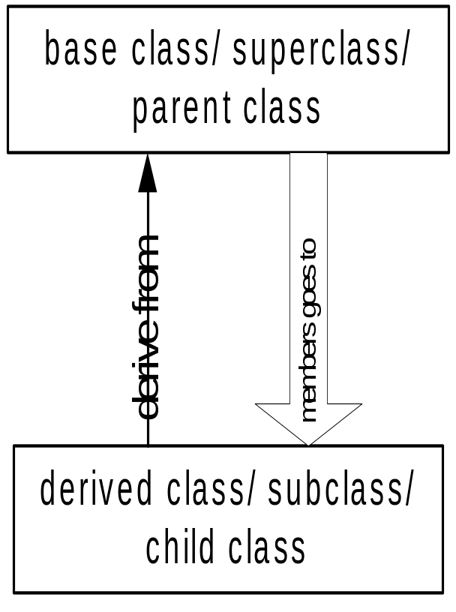
Access Control Over the Members
Two levels of access control over class members
  class definition
  inheritance type
class Point{
protected: int x, y;
public: void set(int a, int b);
};
class Circle : public Point{
… …
};

Slide 11
Access Rights of Derived Classes
Type of Inheritance
 | private | protected | public
private | - | - | -
protected | private | protected | protected
public | private | protected | public
Access Control
for Members
The type of inheritance defines the access level for the members of derived class that are inherited from the base class

Slide 12
Class Derivation
class mother{
protected: int mProc;
public: int mPubl;
private: int mPriv;
};
class grandDaughter : public daughter {
private: double gPriv;
public: void gFoo ( );
};
private/protected/public
int main() {
/*….*/
}
class daughter : --------- mother{
private: double dPriv;
public: void mFoo ( );
};
class daughter : --------- mother{
private: double dPriv;
public: void dFoo ( );
};
void daughter :: dFoo ( ){
mPriv = 10; //error
mProc = 20;
};

Slide 13
What to inherit?
In principle, every member of a base class is inherited by a derived class
  just with different access permission
However, there are exceptions for
  constructor and destructor
  operator=() member
  friends
Since all these functions are class-specific

Slide 14
Constructor Rules for Derived Classes
The default constructor and the destructor of the base class are always called when a new object of a derived class is created or destroyed.
class A {
public:
A ( )
{cout<< “A:default”<<endl;}
A (int a)
{cout<<“A:parameter”<<endl;}
};
class B : public A
{
public:
B (int a)
{cout<<“B”<<endl;}
};
output:
A:default
B
B test(1);

Slide 15
Constructor Rules for Derived Classes
You can also specify an constructor of the base class other than the default constructor
  DerivedClassCon ( derivedClass args ) : BaseClassCon ( baseClass args )
  { DerivedClass constructor body }
class A {
public:
A ( )
{cout<< “A:default”<<endl;}
A (int a)
{cout<<“A:parameter”<<endl;}
};
class C : public A {
public:
C (int a) : A(a)
{cout<<“C”<<endl;}
};
output:
A:parameter
C
C test(1);

Slide 16
Define its Own Members
The derived class can also define its own members, in addition to the members inherited from the base class
class Point{
protected:
int x, y;
public:
void set(int a, int b);
};
Point
x
y
x
y
r
Circle
class Circle{
protected:
int x, y;
private:
double r;
public:
void set(int a, int b);
void set_r(double c);
};
class Circle : public Point{
private:
double r;
public:
void set_r(double c);
};

Slide 17
Even more …
A derived class can override methods defined in its parent class. With overriding,
  the method in the subclass has the identical signature to the method in the base class.
  a subclass implements its own version of a base class method.
class A {
protected:
int x, y;
public:
void print ()
{cout<<“From A”<<endl;}
};
class B : public A {
public:
void print ()
{cout<<“From B”<<endl;}
};

Slide 18
Access a Method
class Point{
protected:
int x, y;
public:
void set(int a, int b)
{x=a; y=b;}
void foo ();
void print();
};
class Circle : public Point{
private: double r;
public:
void set (int a, int b, double c) {
Point :: set(a, b); //same name function call
r = c;
}
void print(); };
Circle C;
C.set(10,10,100); // from class Circle
C.foo (); // from base class Point
C.print(); // from class Circle
Point A;
A.set(30,50); // from base class Point
A.print(); // from base class Point

Slide 19
Putting Them Together
Time is the base class
ExtTime is the derived class with public inheritance
The derived class can
  inherit all members from the base class, except the constructor
  access all public and protected members of the base class
  define its private data member
  provide its own constructor
  define its public member functions
  override functions inherited from the base class
Time
ExtTime

Slide 20
class Time Specification
// SPECIFICATION FILE ( time.h)
class Time{
public :
void Set ( int h, int m, int s ) ;
void Increment ( ) ;
void Write ( ) const ;
Time ( int initH, int initM, int initS ) ; // constructor
Time ( ) ; // default constructor
protected :
int hrs ;
int mins ;
int secs ;
} ;

Slide 21
Class Interface Diagram
Time class
Set
Protected data:
hrs
mins
secs
Increment
Write
Time
Time

Slide 22
Derived Class ExtTime
// SPECIFICATION FILE ( exttime.h)
#include “time.h”
enum ZoneType {EST, CST, MST, PST, EDT, CDT, MDT, PDT } ;
class ExtTime : public Time
// Time is the base class and use public inheritance
{
public :
void Set ( int h, int m, int s, ZoneType timeZone ) ;
void Write ( ) const; //overridden
ExtTime (int initH, int initM, int initS, ZoneType initZone ) ;
ExtTime (); // default constructor
private :
ZoneType zone ; // added data member
} ;

Slide 23
Class Interface Diagram
ExtTime class
Set
Set
Increment
Increment
Protected data:
hrs
mins
secs
Write
Write
ExtTime
Time
ExtTime
Time
Private data:
zone

Slide 24
Implementation of ExtTime
Default Constructor
ExtTime :: ExtTime ( )
{
zone = EST ;
}
ExtTime et1;
et1
hrs = 0
mins = 0
secs = 0
zone = EST
The default constructor of base class, Time(), is automatically called, when an ExtTime object is created.

Slide 25
Implementation of ExtTime
Another Constructor
ExtTime :: ExtTime (int initH, int initM, int initS, ZoneType initZone)
: Time (initH, initM, initS)
// constructor initializer
{
zone = initZone ;
}
ExtTime *et2 =
new ExtTime(8,30,0,EST);
5000
hrs = 8
mins = 30
secs = 0
zone = EST
et2
6000
???
5000

Slide 26
Implementation of ExtTime
void ExtTime :: Set (int h, int m, int s, ZoneType timeZone)
{
Time :: Set (hours, minutes, seconds); // same name function call
zone = timeZone ;
}
void ExtTime :: Write ( ) const // function overriding
{
string zoneString[8] =
{“EST”, “CST”, MST”, “PST”, “EDT”, “CDT”, “MDT”, “PDT”} ;
Time :: Write ( ) ;
cout <<‘ ‘<<zoneString[zone]<<endl;
}

Slide 27
Working with ExtTime
#include “exttime.h”
… …
int main()
{
ExtTime thisTime ( 8, 35, 0, PST ) ;
ExtTime thatTime ; // default constructor called
thatTime.Write( ) ; // outputs 00:00:00 EST
thatTime.Set (16, 49, 23, CDT) ;
thatTime.Write( ) ; // outputs 16:49:23 CDT
thisTime.Increment ( ) ;
thisTime.Increment ( ) ;
thisTime.Write ( ) ; // outputs 08:35:02 PST
}

Slide 28
Take Home Message
Inheritance is a mechanism for defining new class types to be a specialization or an augmentation of existing types.
In principle, every member of a base class is inherited by a derived class with different access permissions, except for the constructors

